Slide 1

Engineering Design & Development
Vishwakarma Institute of Technology, Pune
Tax Collection Software using MySQL and Python
Project By:
Pranesh Kulkarni
Anjali Gaikwad
Anamika Rathod
Ankita Chirame
Prathamesh Dhasade
Shraddha Kshirsagar
Guided By:
Prof. A. J. Tathe

Slide 2
Tools and Softwares
My SQL workbench 8.0 CE and My SQL server 8.0
Tkinter
PAGE GUI builder 4.19
Pycharm Community version 2018.3.3
ActiveTCL 8.6.8.0
pyinstaller
SMTP
Openpyxl and Reportlab
dbConnect and mysql.connector

Slide 3
Why MySQL ?
Data Security
High Performance
Round-the-clock Uptime
On-Demand Scalability
Reduced Total Cost of Ownership
The Flexibility of Open Source

Slide 4
Features
MySQL Database
Online Data Recovery
Secure Online Login from Authorized person
Unique User ID for each person in village
Online Support
Email Receipt
Easy to Use
User friendly Interface
Tax calculator
Data Can be Accessed anytime, anywhere
Safe Data modification

Slide 5
Project Objective
To Bring transparency and efficiency in tax collection in rural areas.
To access the data anytime anywhere.
To reduce paperwork.
Digitalization
To make centralized tax collection process

Slide 6
Modules
eTAX 2019
TAX CALCULATOR
ONLINE DATA RECOVERY
UPDATE DATA
TECHNICAL SUPPORT
CONNECT THE WORLD
VIEW DATABASE
ADD NEW ENTRIES
WORKSPACE

Slide 7
How it works ?
Online Registration From Official Website
Creating unique id and password for village
Connecting client to main server
Connecting software to database
Creating new table for village
Online Login to the main application

Slide 8
How it works ?
Connecting to SMTP server
Adding tax values to the database which has been paid by user
Connecting to the table 2
Adding tax values to the database
Calculating tax for each person
Adding new entries to the database

Slide 9
How it works ?
Sending email and text message of confirmation of payment to consumers
Connecting to MySQL server
Saving all the data to the database
Disconnecting from the server

Slide 10
How one can access the data ?
1
3
Fetching all the data from the database
4
Displaying all the entries and values
2
Connecting to MySQL server
Connecting to the specific Table of the village

Slide 11
How one can modify previously entered data ?
Secure login by authorized person
Requesting the administrator for modification
Sending required details to the administrator
Taking backup of all modified data
Deleting data from village database by administrator (Through Administrator Suit)

Slide 12
Online Support
Reporting a Bug
Giving ratings and feedback to developers
Online data recovery
Solving Server Connection problems
Solving Data modification issues
Solving Internal application Problems

Slide 13
Future Scope
UI can be enhanced by using better tools of graphics designing
Android app development
Double Authentication
Use of SMS services instead of email service
Use of cloud databases
Connecting MySQL server to official Website

Slide 14
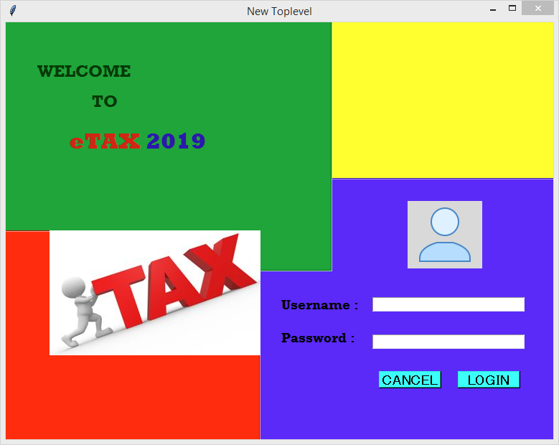
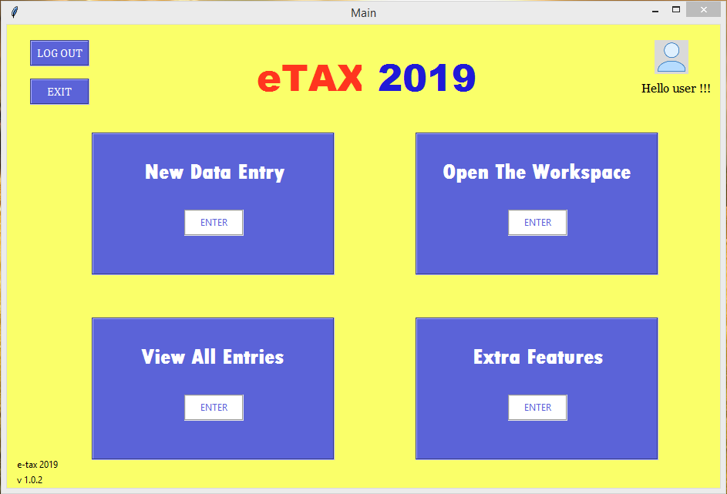
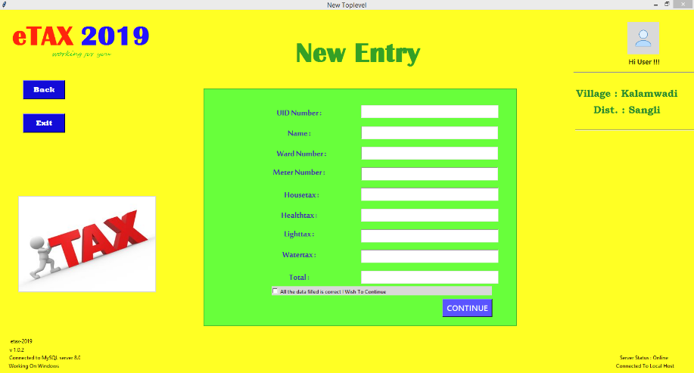
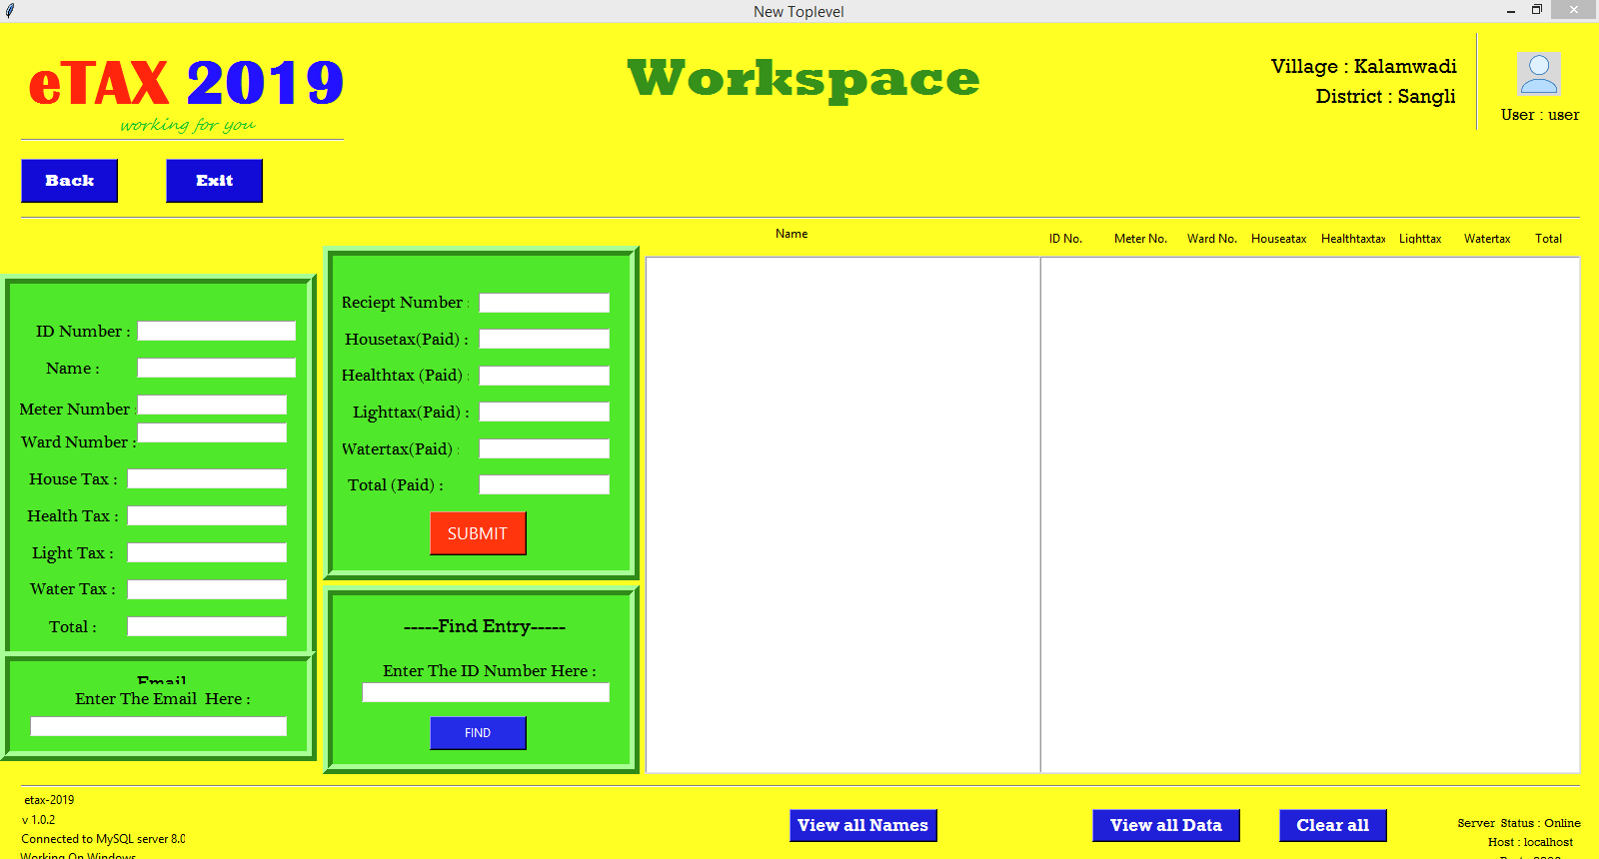
Screen Shots

Slide 15
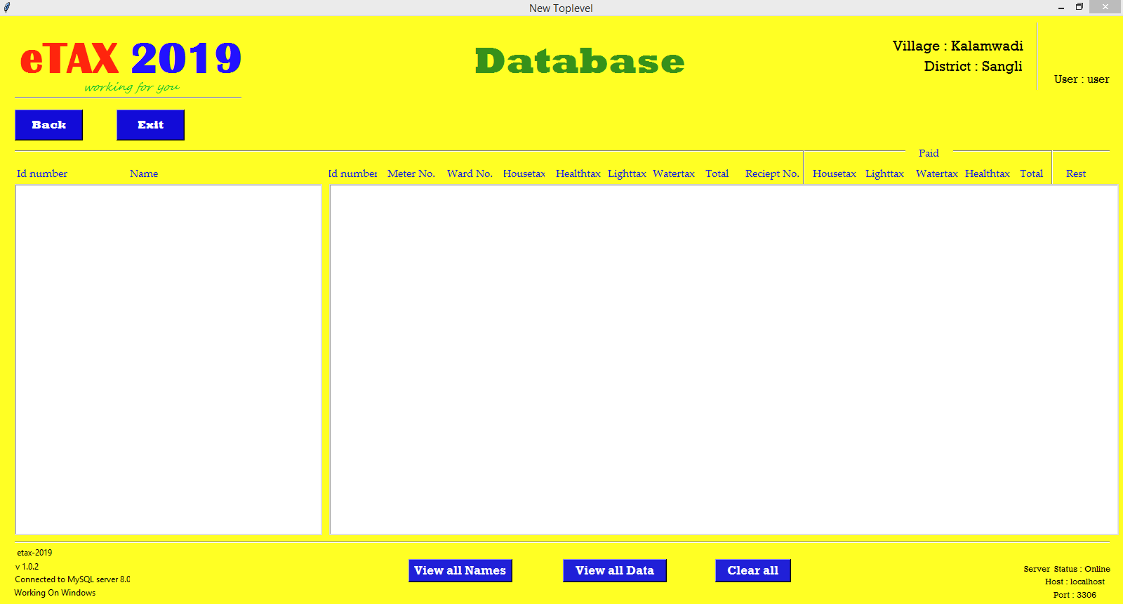
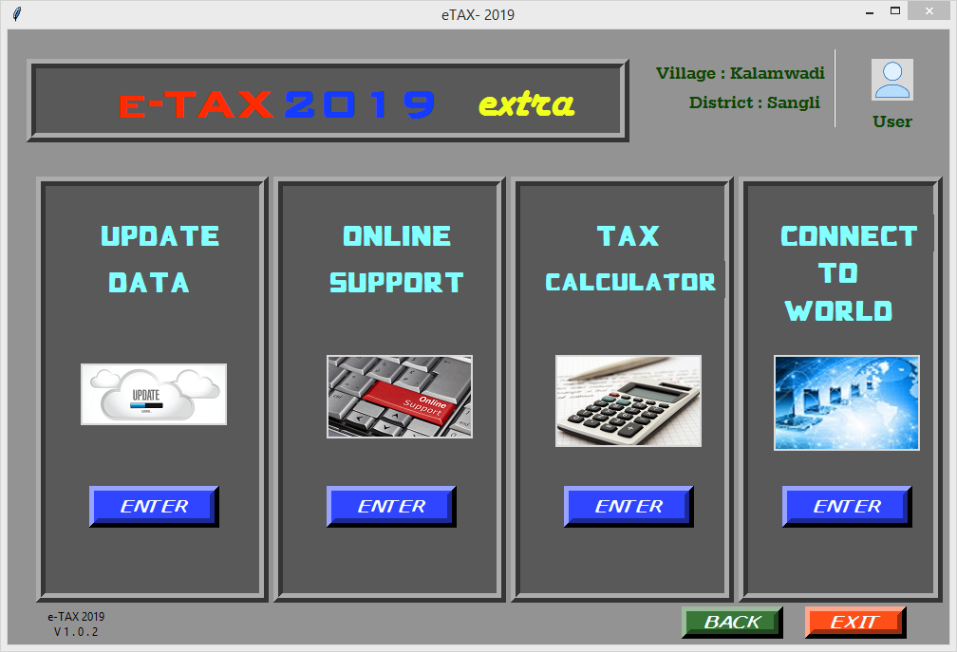
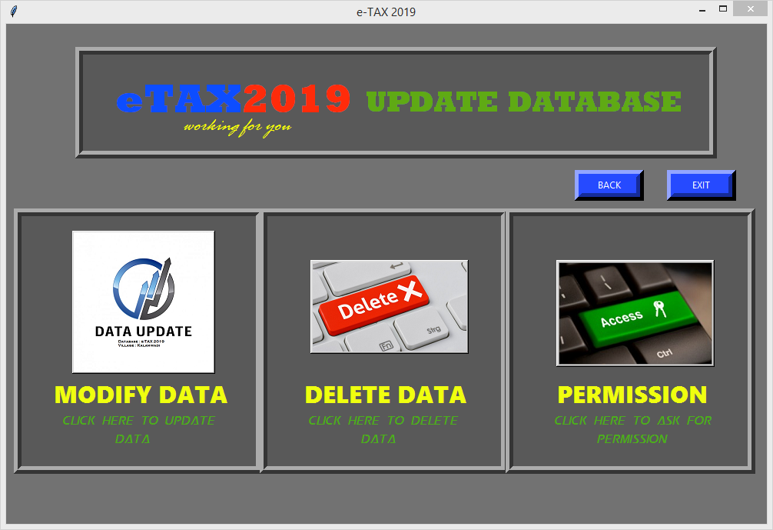
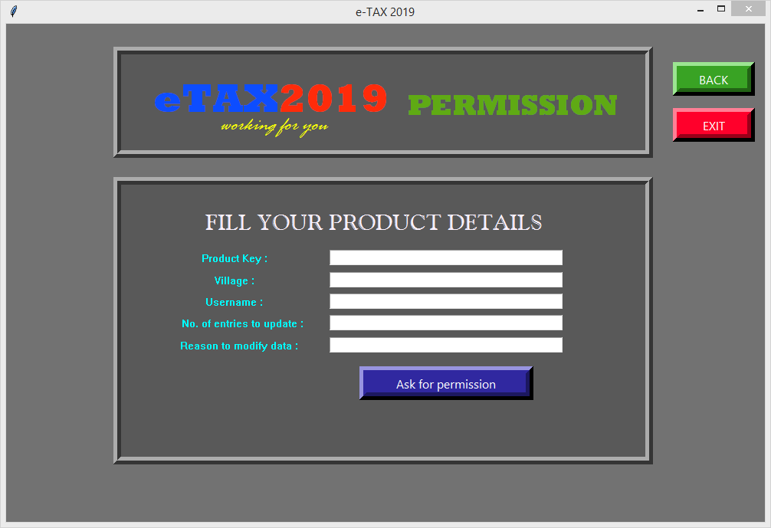

Slide 16
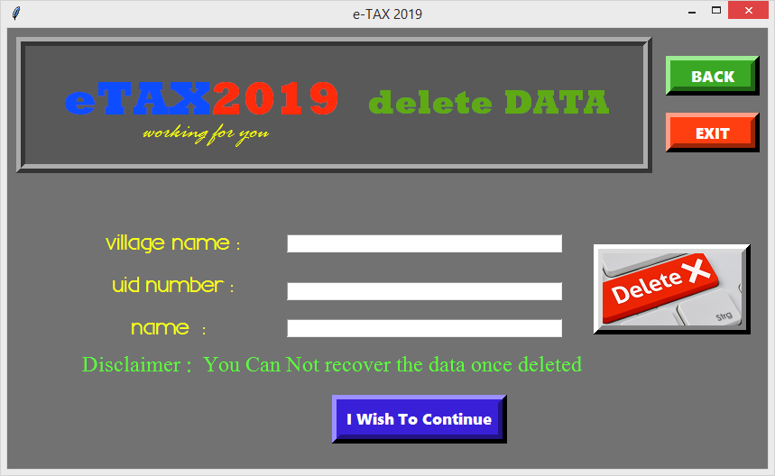
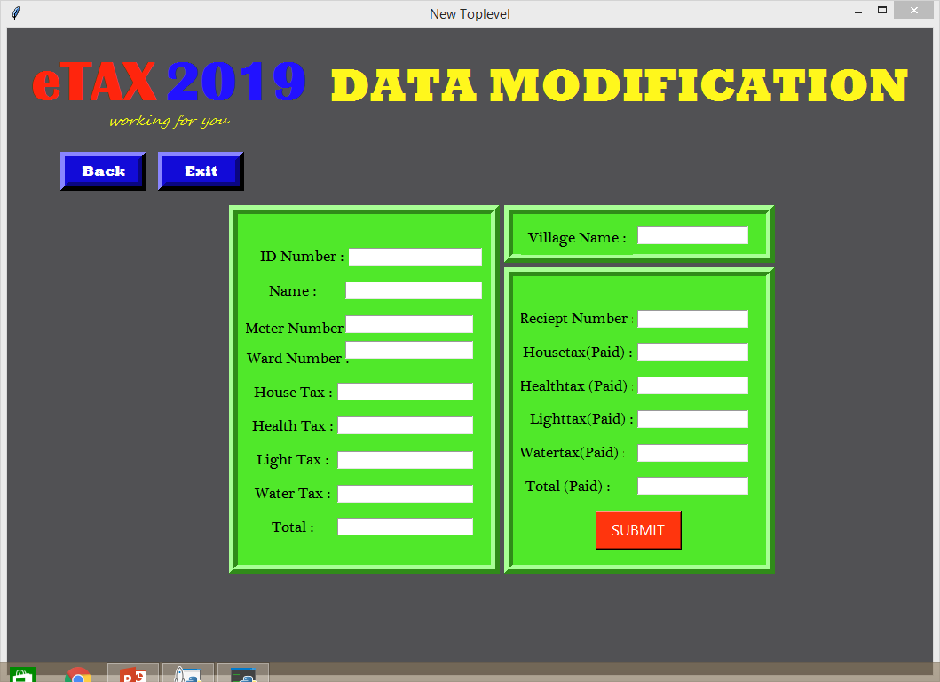
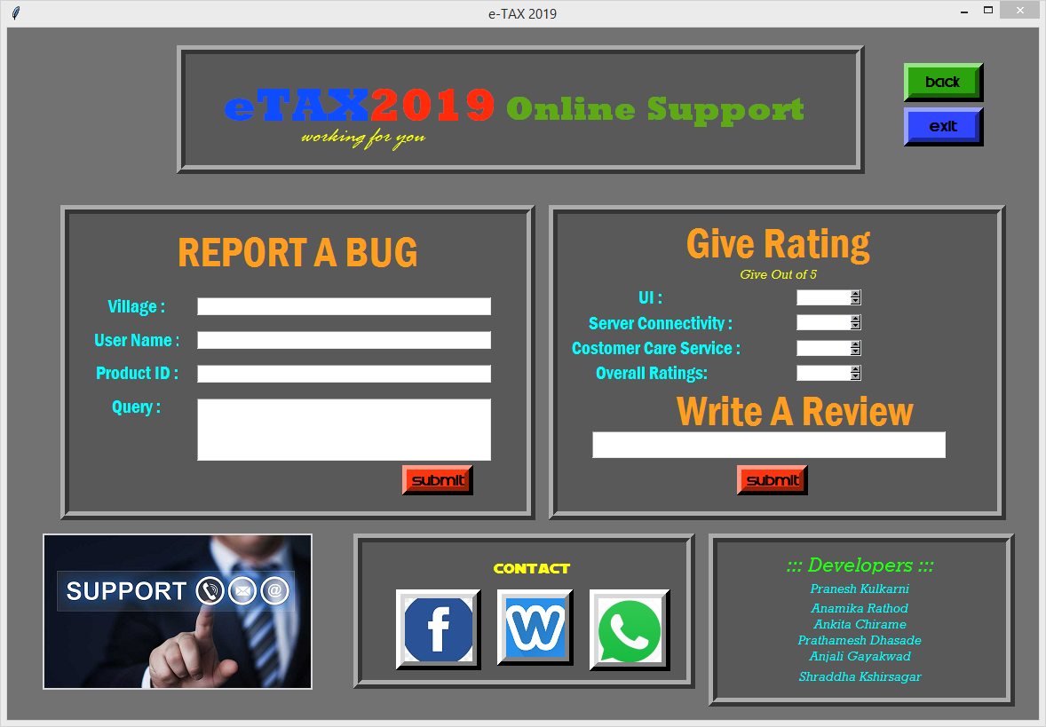
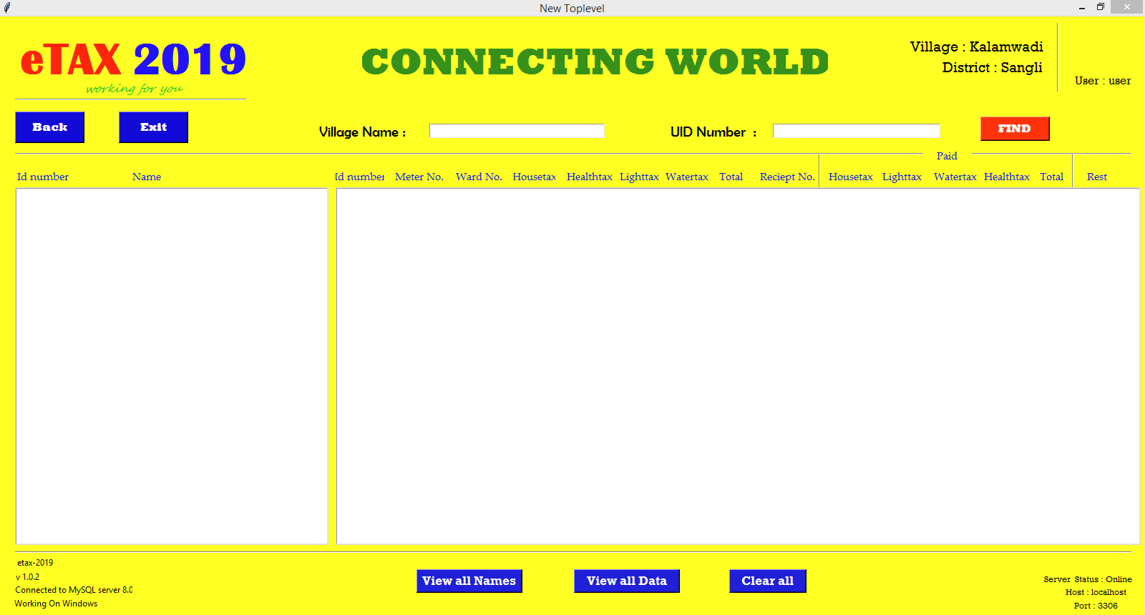

Slide 17
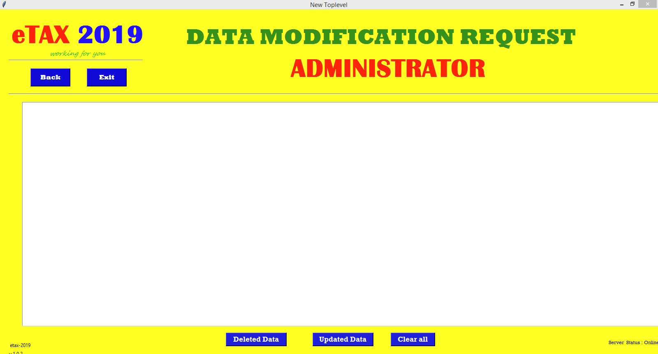
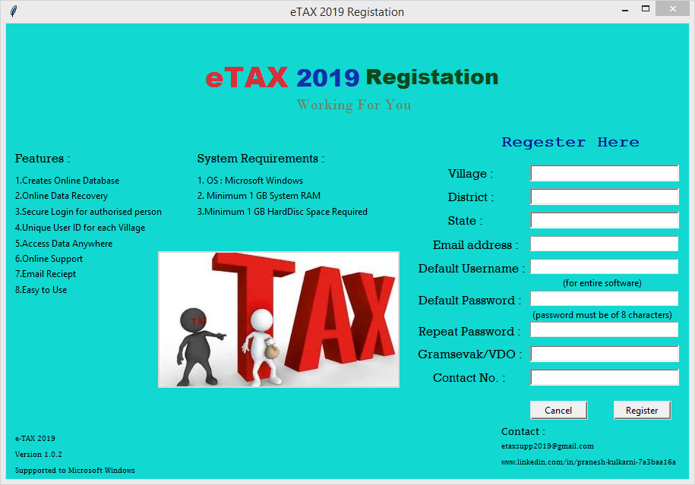
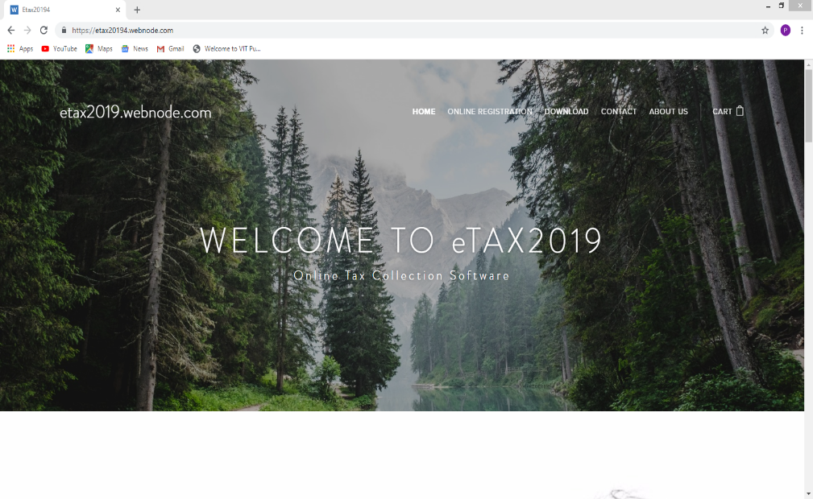
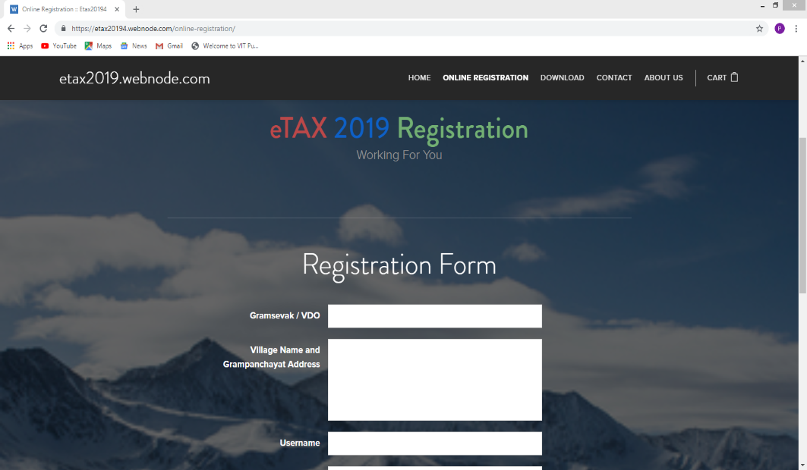

Slide 18
THANK YOU

